Slide 1
Computer
A computer is an electronic machine that takes input, processes it, and gives output. It works very fast and accurately. Computers are used in almost every field like education, business, banking, hospitals, and entertainment.
The quick brown fox jumps over the lazy dog. The quick brown fox jumps over the lazy dog. The quick brown fox jumps over the lazy dog. The quick brown fox jumps over the lazy dog. The quick brown fox jumps over the lazy dog.

Slide 2
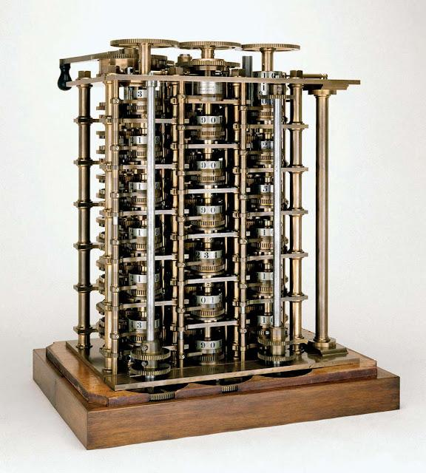
History of Computer
➤ Abacus
First calculating device (around 3000 BC)
Used for basic arithmetic (addition, subtraction)
➤ Napier’s Bones
Invented by John Napier
Used for multiplication and division
➤ Pascaline
Invented by Blaise Pascal
First mechanical calculator

Slide 3
Difference Between RAM and ROM
RAM
ROM
Full Form: Random Access Memory
Type: Volatile memory (data lost when power is OFF)
Use: Stores temporary data while working
Speed: Very fast
Example: Running apps, open files
Editable: Yes (Read & Write)
Full Form: Read Only Memory
Type: Non-volatile memory (data stays even when power is OFF)
Use: Stores permanent instructions
Speed: Slower than RAM
Example: Booting instructions (BIOS)
Editable: No (mostly read-only)

Slide 4
Task 1: Preapre the Chart for Data

Slide 5
Computer On
Open Softwares
Explore the Software
Close the Soft

